Slide 1
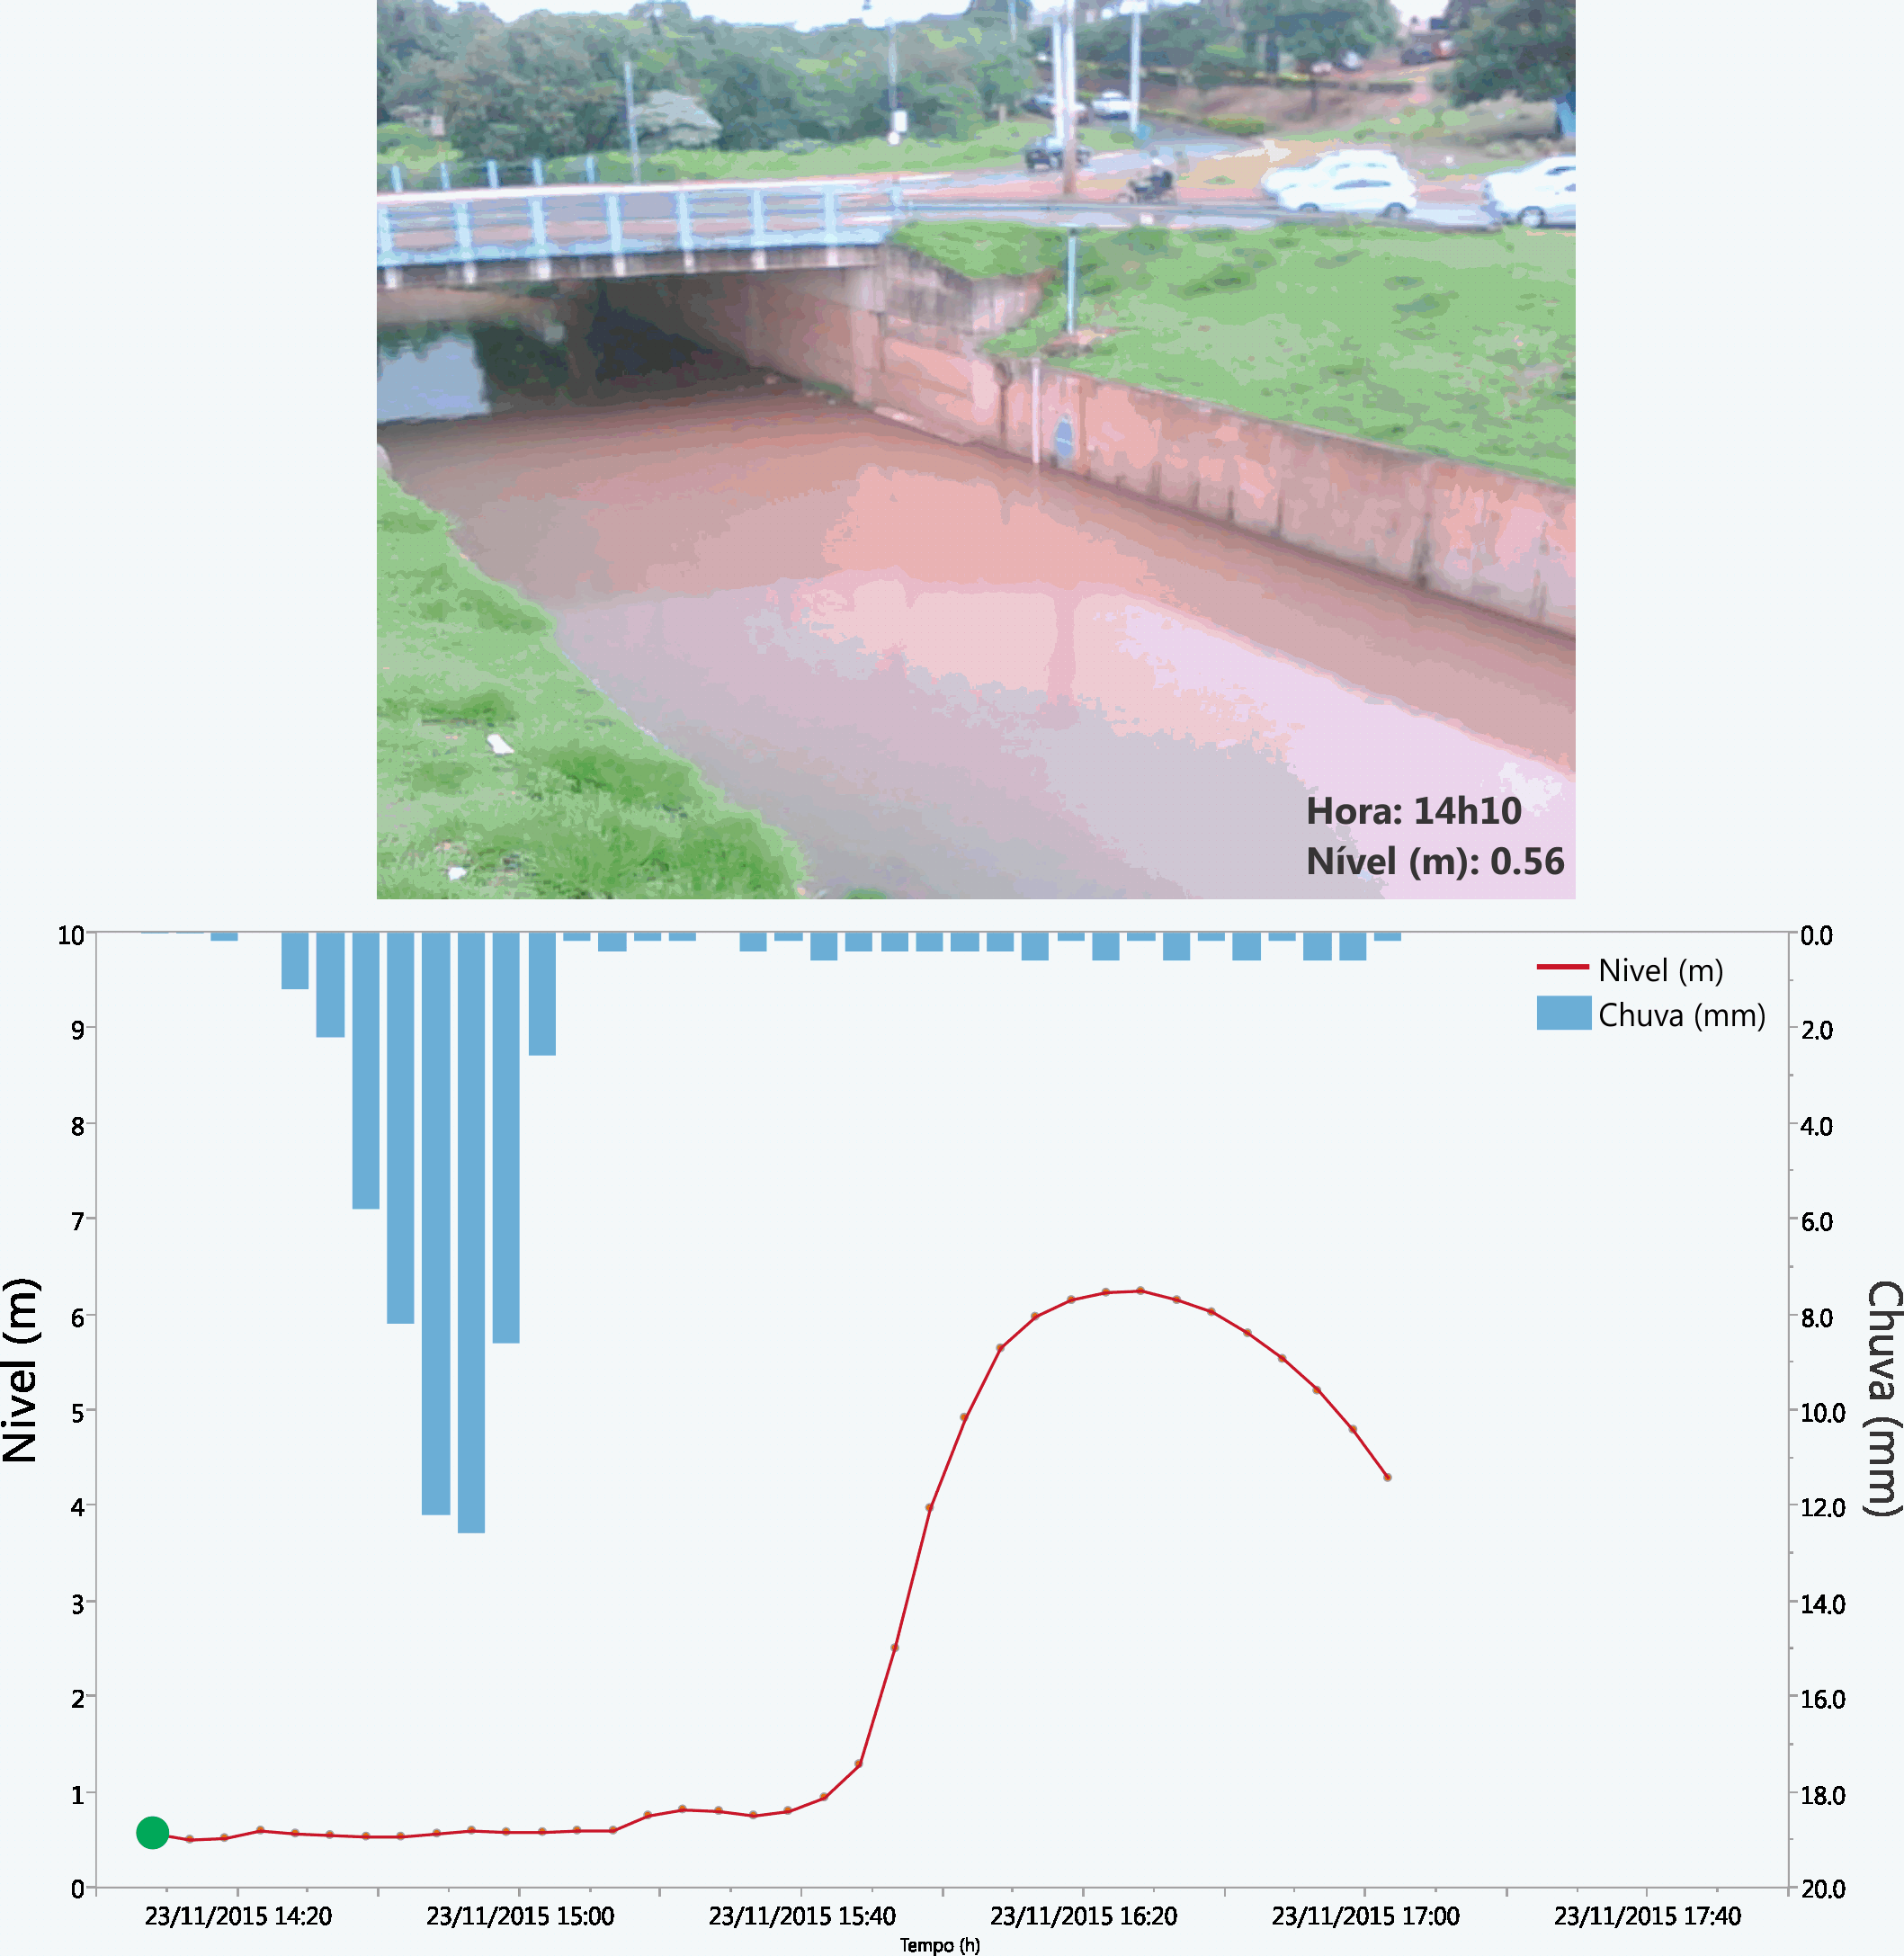
Subtropical Urban Flood (Drainage Area=77km²) São Carlos City, Sao Paulo State, Brazil, 23 Nov., 2015.
Title: Experimental river monitoring
Year: 2015
Credits: Narumi Abe, Maria Clara Fava, E M Mendiondo, J. Porto de Albuquerque, J. Ueyama
Projects: CAPES Pró-Alertas 88887.091743, USP/CEPED-CEMADEN/MCTIC, FAPESP nº 12/22550-0, FAPESP-CNPq-PRONEX 08/58161-1, FAPESP 2014/50848-9 (Water Security; INCT-MC-II)
Support: The WADI Lab (www.eesc.usp.br/shs)

